Slide 1

Working with HDFS

Slide 2
Constraints on the Combiner Function

Slide 3

Map Reduce
Can we simply use the reducer as a combiner?
It must satisfy some basic criteria before it is used as combiners
Reduce operation is partially parallelized.
Less data needs to be transferred across the network.
The combiner function should have no impact on the final result .
Whether it is used or not the results should be the same.

Slide 4
Map Reduce
Can a combiner affect the results?
A file contains 3 columns Players, Runs Scored, Match
Compute the batting average of each player
Can we use average( ) as the combiner function?

Slide 5
Map Reduce
Example – Without a Combiner
Data Node 1
<virat,101>
<virat,30>
Virat,101,M1
Virat, 30,M2
Map
<virat,101,30,98>
<Dhoni,78>
<Sachin,90>
<Dinesh,60>
<virat, 76>
<Dhoni,78>
<Sachin,90>
<Dinesh,60>
Data Node 2
<virat,98>
<Dhoni,78>
Map
Reduce
Virat,98,M3
Dhoni,78,M4
Data Node 3
<sachin,90>
<Dinesh,60>
Sachin,90,M5
Dinesh, 60,M4
Map

Slide 6
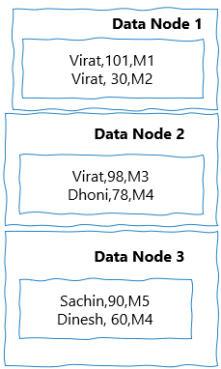
Map Reduce
Example –With Combiner
Map/combine
<virat,66>
<virat,66,98>
<Dhoni,78>
<Sachin,90>
<Dinesh,60>
<virat, 82>
<Dhoni,78>
<Sachin,90>
<Dinesh,60>
Map
<virat,98>
<Dhoni,78>
Reduce
<sachin,90>
<Dinesh,60>
Map

Slide 7
Map Reduce
Can a combiner affect the results?
<virat, 76>
<Dhoni,78>
<Sachin,90>
<Dinesh,60>
<virat, 82>
<Dhoni,78>
<Sachin,90>
<Dinesh,60>
Result is different with
and without combiner

Slide 8
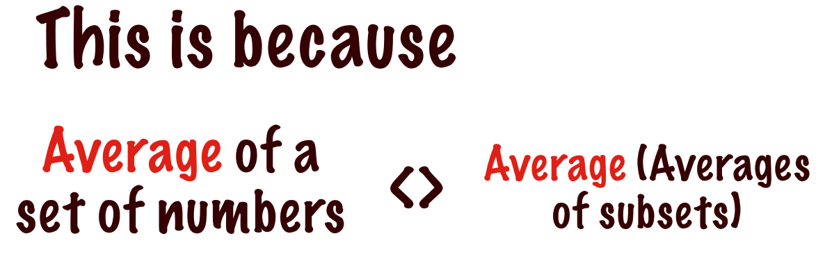
Map Reduce
Why this variation?

Slide 9
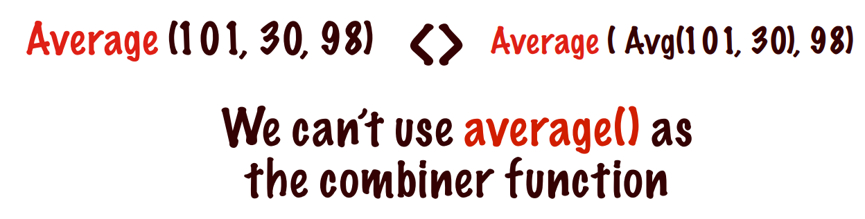
Map Reduce
Why this variation?

Slide 10
Shuffle/Sort

Slide 11
Map Reduce
How many mappers and reducers are required for a map reduce Job?
# Mappers | # Reducers
Number of mappers is controlled by YARN | Number of reducers is controlled by user
Each Mapper operates on one HDFS block | By default there is only one reducer
It depends on the number of splits | With multiple reducers the reduce task can also be parallelized
Multiple mappers can be assigned to one data block | The number of reducers can be specified
Can only be controlled to a limited extend by the user | Controlled by the user

Slide 12
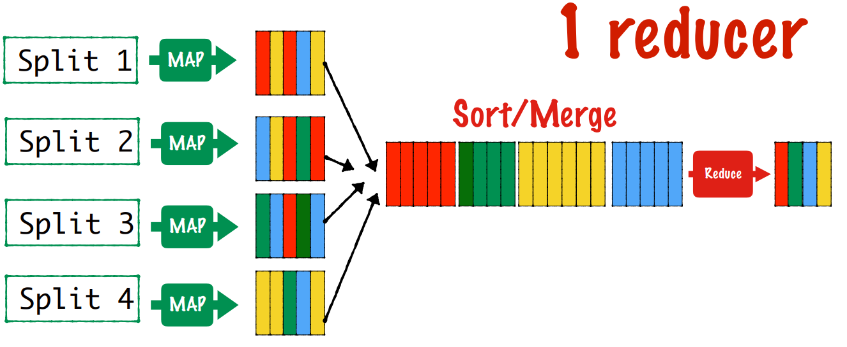
Map Reduce
One Reducer

Slide 13
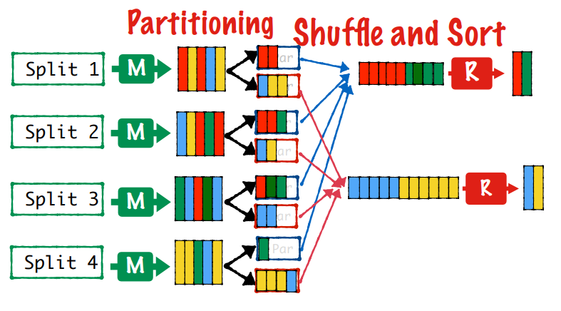
Map Reduce
Multiple reducers

Slide 14
Map Reduce
Question No:1
Input: file(lineNumber, line) records and pattern
Output: lines matching a given pattern
What will be the mapper and reducer? What will be the keys?
Map:
Reduce:

Slide 15
Map Reduce
Question No:1
Input: file (lineNumber, line) records and pattern
Output: lines matching a given pattern
Map: if(line matches pattern): output(line)
Reduce: identity function
Alternative: no reducer (map-only job)

Slide 16
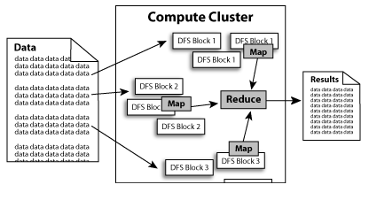
Map Reduce
Traditional Move Data to Compute

Slide 17
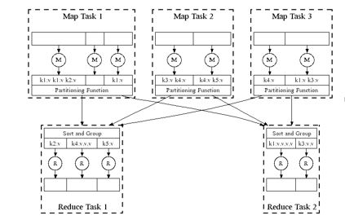
Map Reduce
Big Data Move Data to Compute

Slide 18
Map Reduce
Map Output
Where is Map output written to?
Local disk and not HDFS
Why? Temporary output to be discarded after reduce.
Failure
If the node running the map task fails
before the output has been consumed by reducer
Automatically rerun map task on another node

Slide 19
Map Reduce
Reduce Output
Reduce tasks don’t have the advantage of data locality
the input to a single reduce task is normally the output from all mappers.
Sorted map outputs
have to be transferred across the network
Where to?
To the node where the reduce task is running
Merge data from different mappers
Then passed to the user-defined reduce function.
The output of the reduce is normally stored in HDFS for reliability.
Where is the reduce output stored
1 on the local node where the reduce happens
Other replicas on off-rack nodes.
Consumes network bandwidth

Slide 20
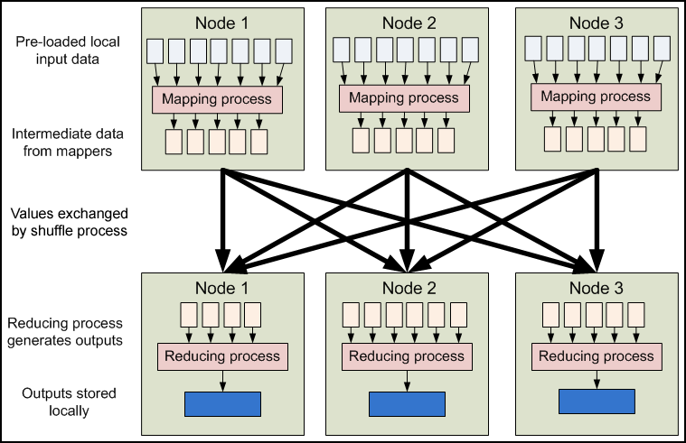
Map Reduce
High Level View

Slide 21
THANK YOU
“WORLD IS ONE BIG DATA PROBLEM”
“TORTURE THE DATA AND IT WILL CONFESS TO ANYTHING”

